Slide 1
Affluence and equity in the context of climate change
Manfred Lenzen, The University of Sydney

Slide 2
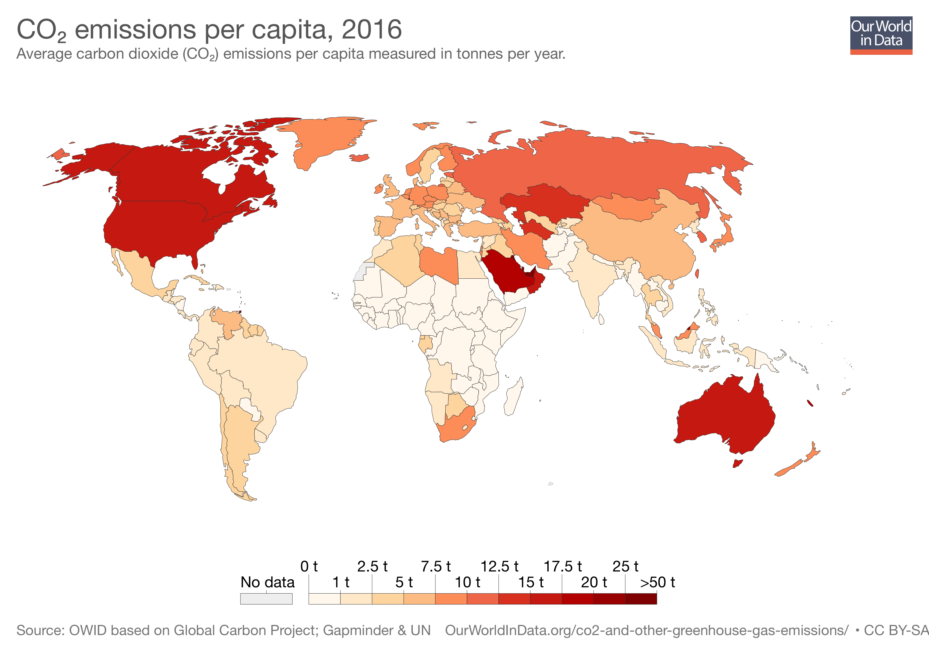
Australia is a top emitter,

Slide 3
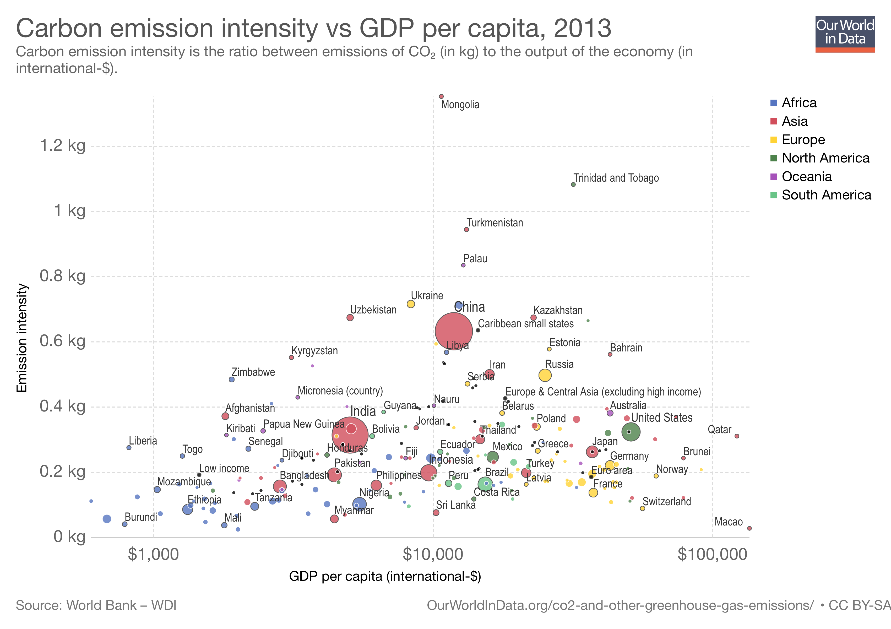
not necessarily because of its high energy intensity

Slide 4
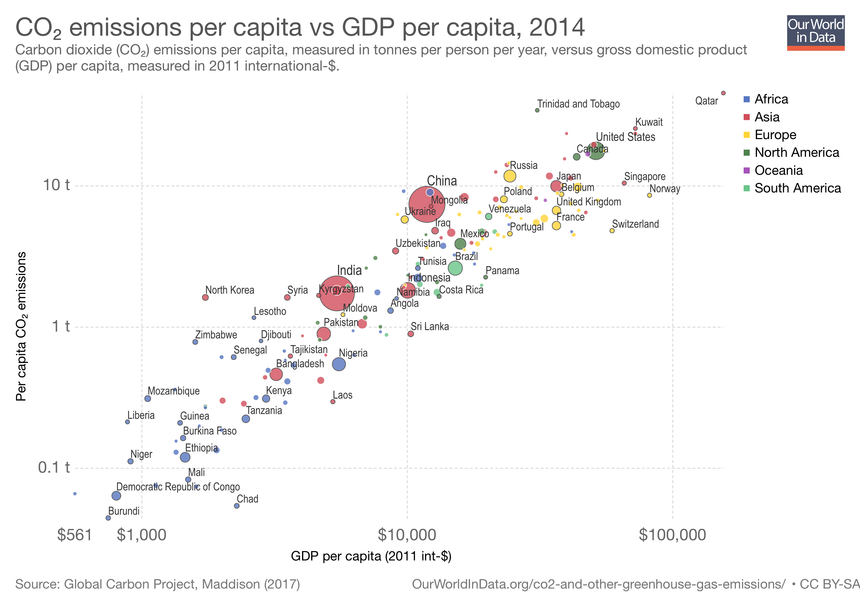
but because of its affluence.
Australia

Slide 5
To have a chance to stay below 1.5ºC, global emissions must halve by 2030,

Slide 6
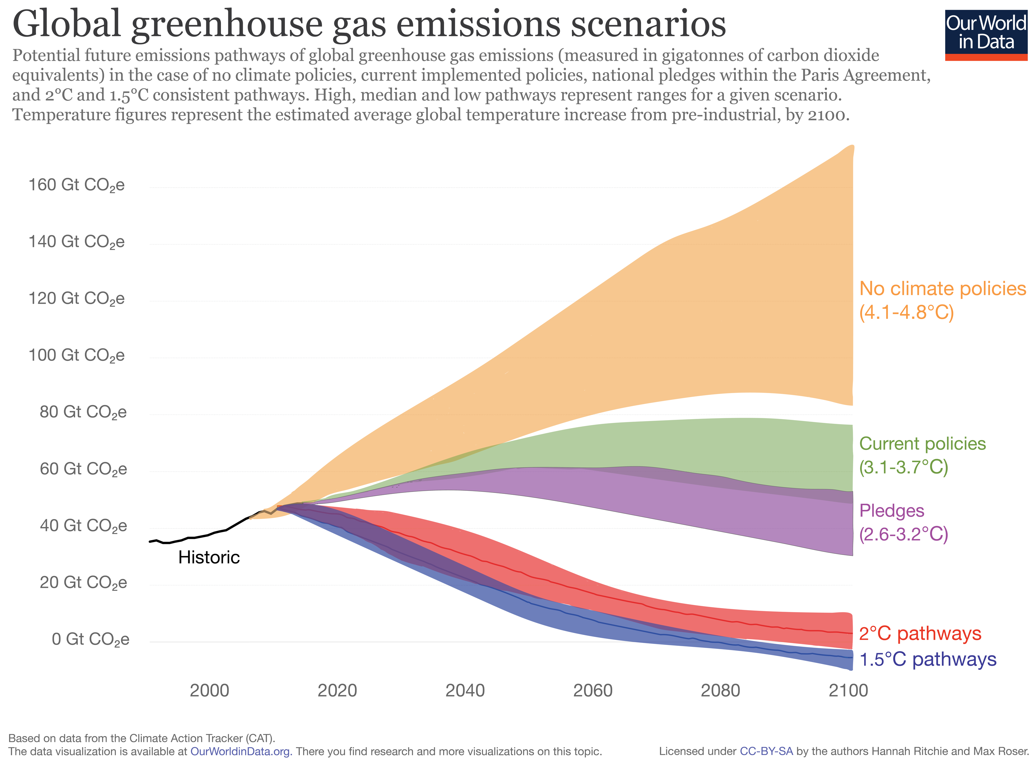
but current pledges entail emissions that are more than twice as high as needed for a 1.5º pathway.

Slide 7
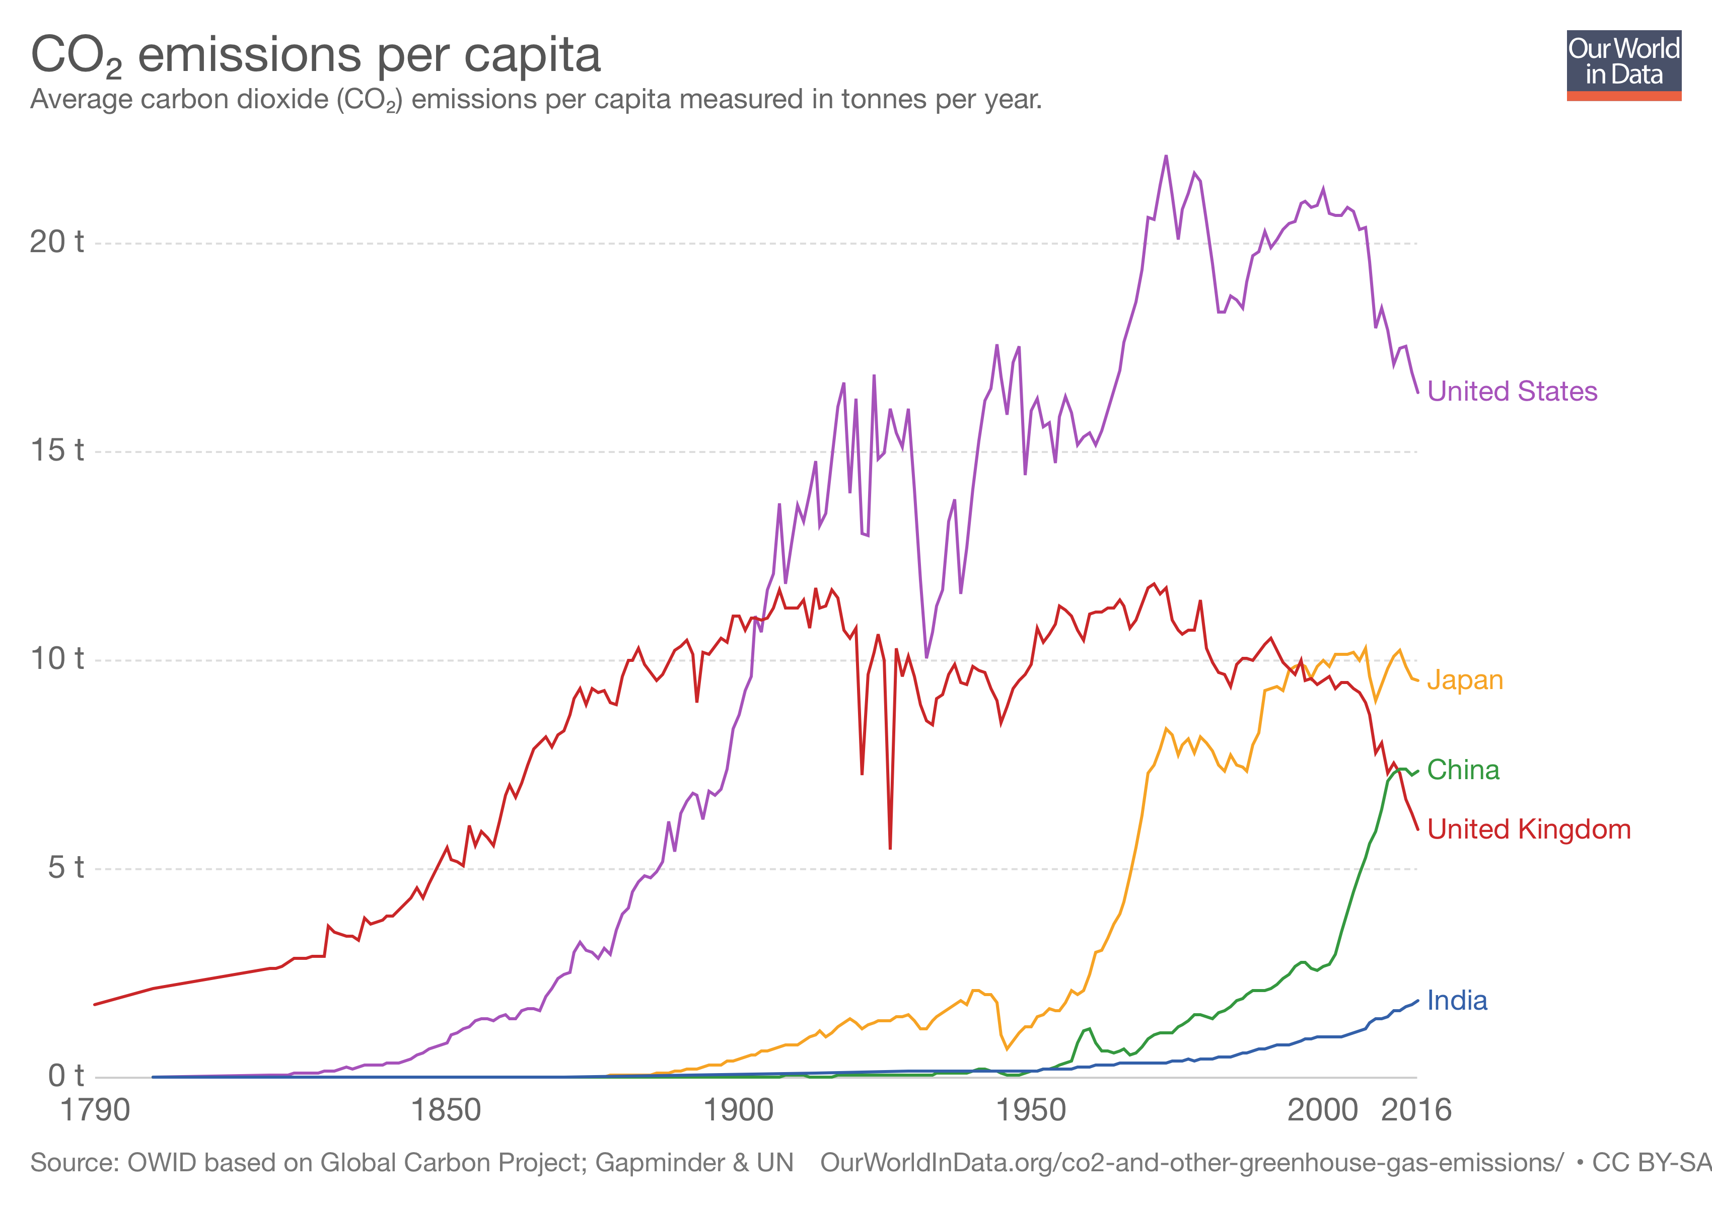
Affluent economies seem to be decarbonising,

Slide 8
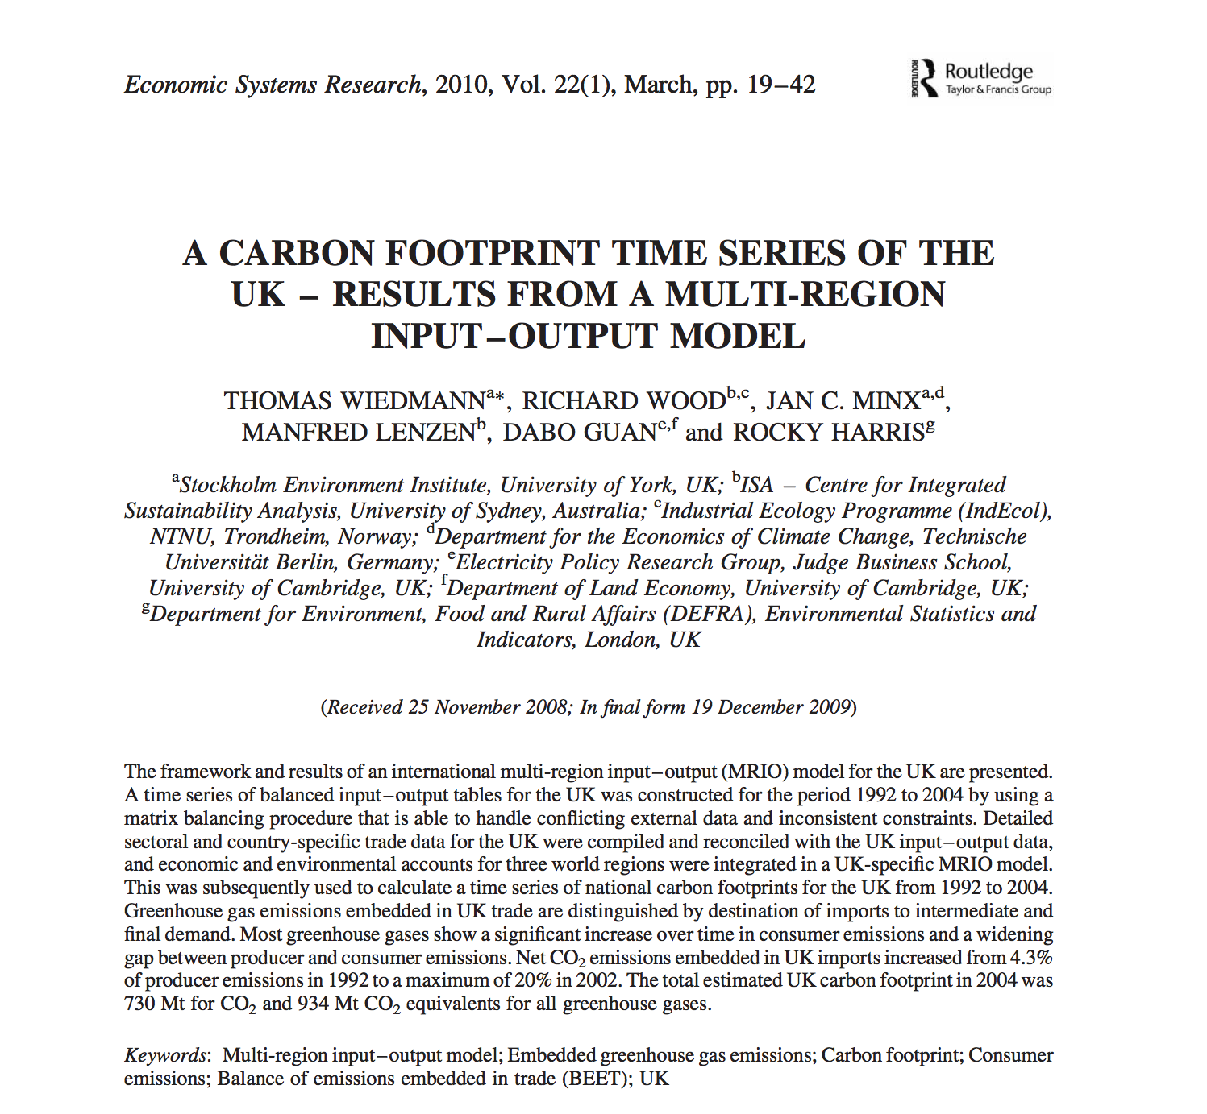
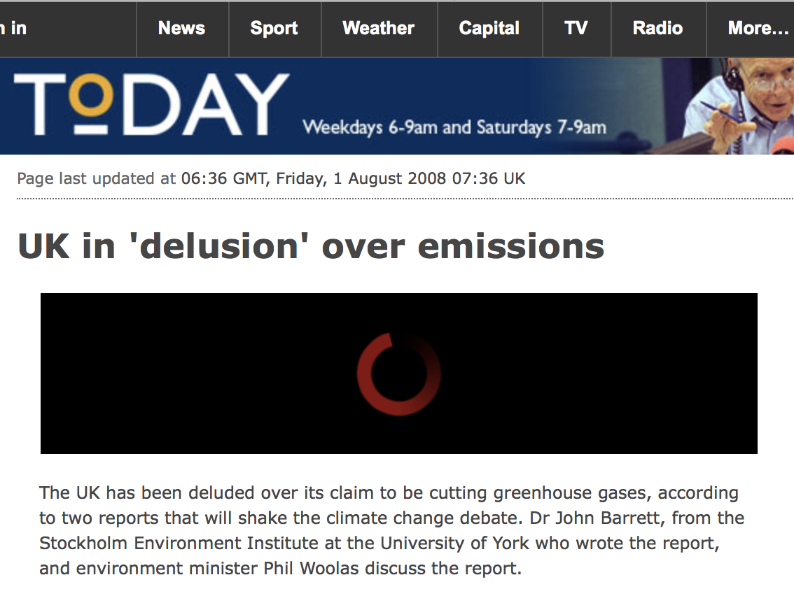
but much of these reductions is due to outsourcing

Slide 9
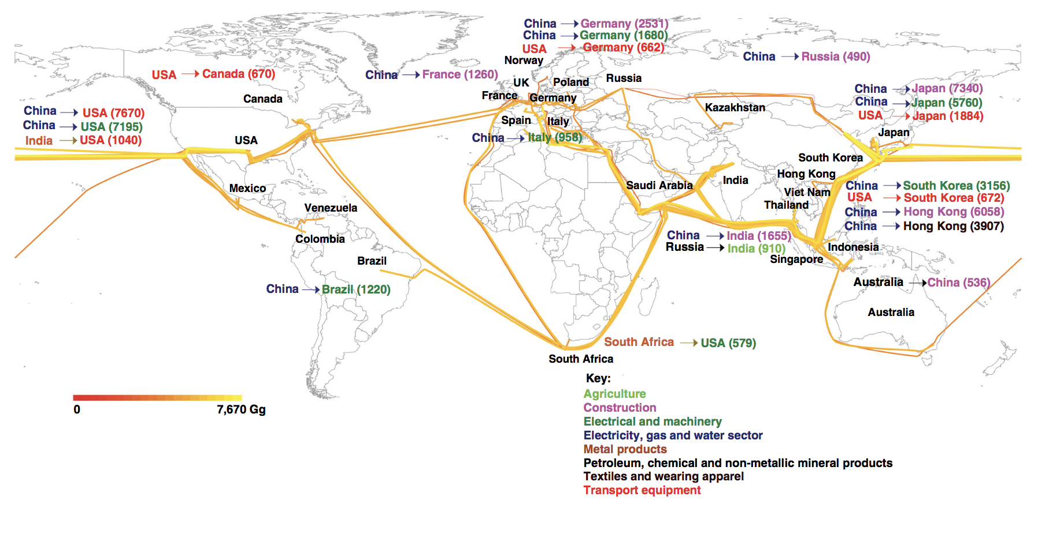
along numerous international trade routes.

Slide 10
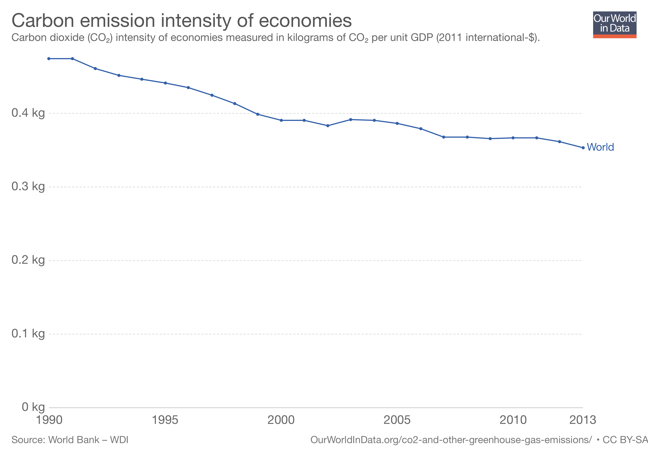
The world’s production is becoming more efficient at about 2% per year,

Slide 11
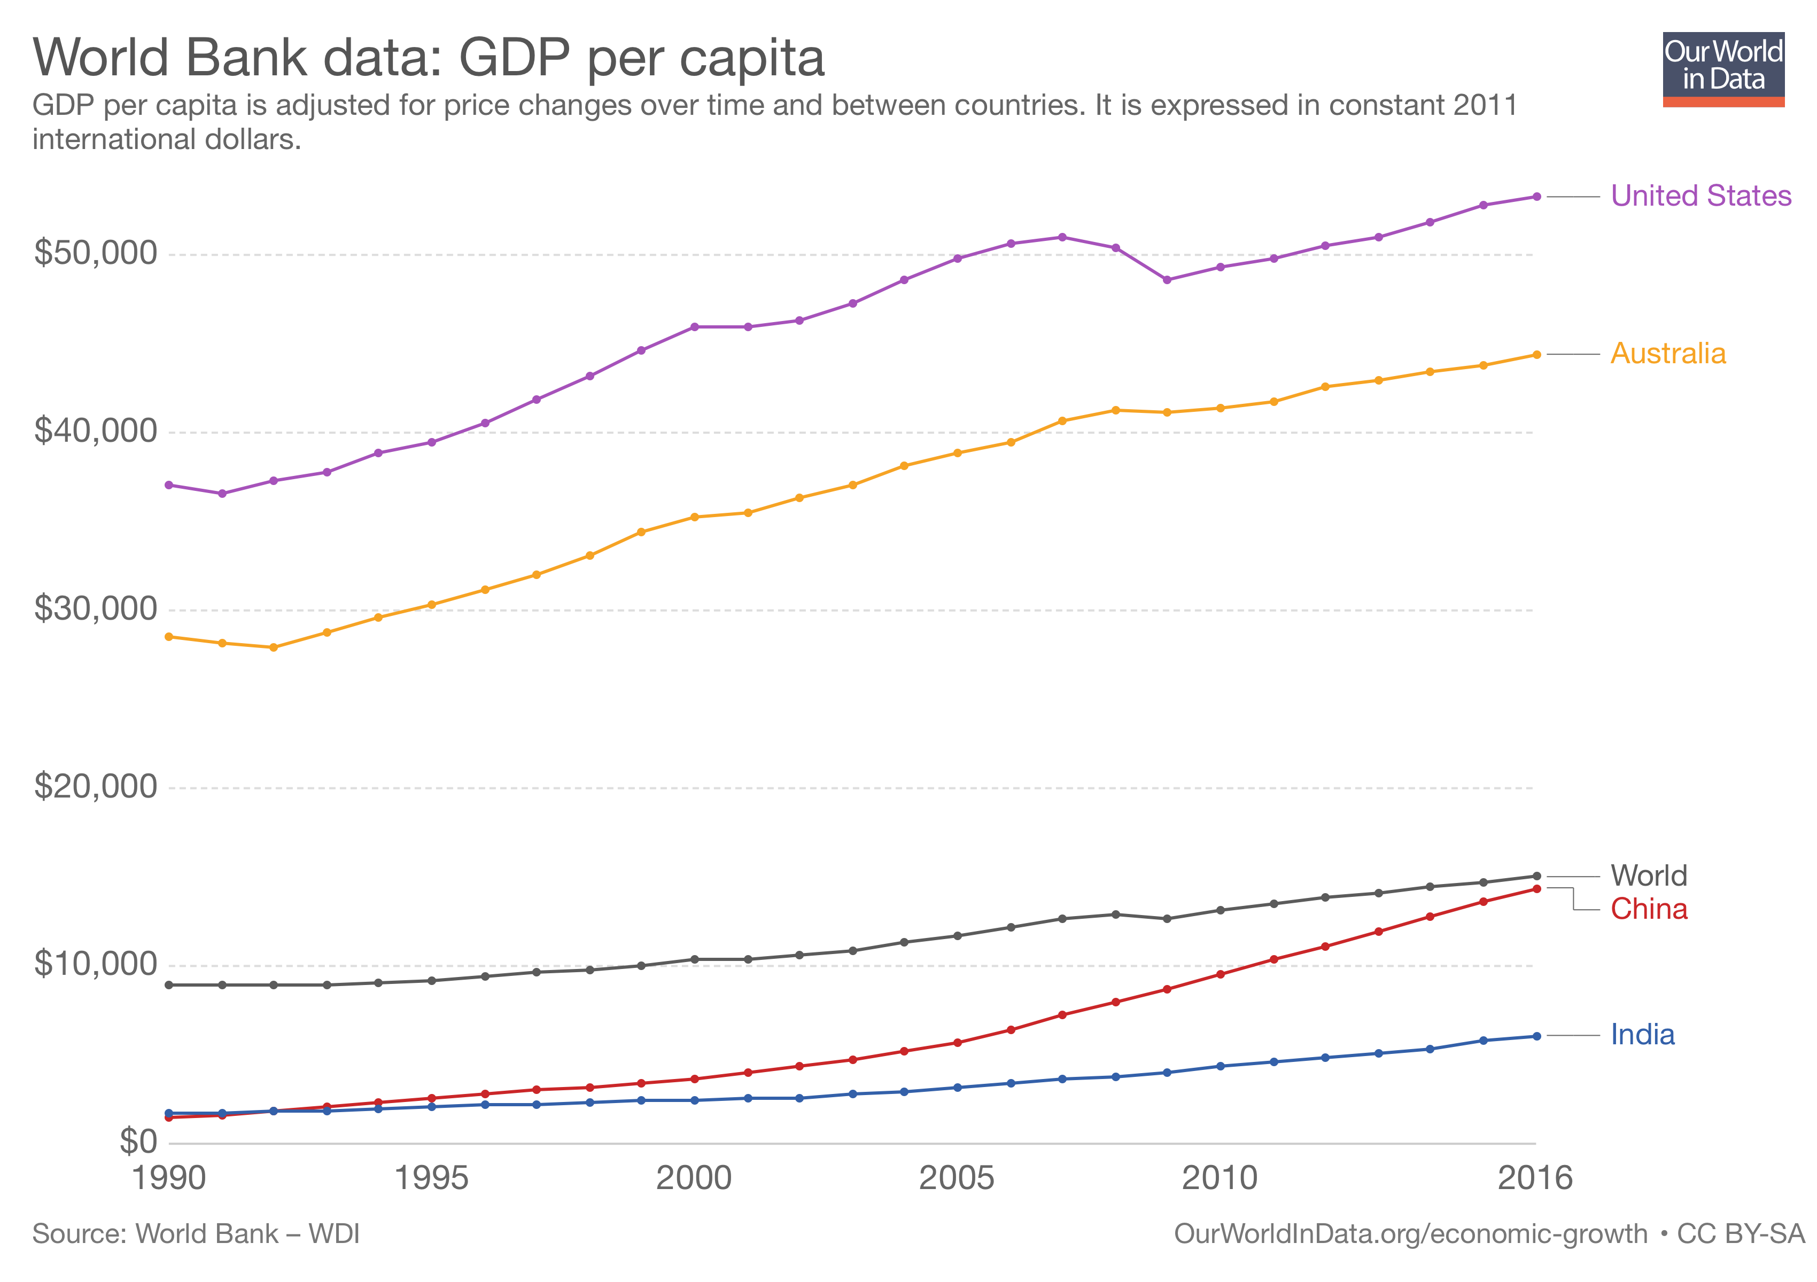
but affluence is growing at 3% per year,

Slide 12
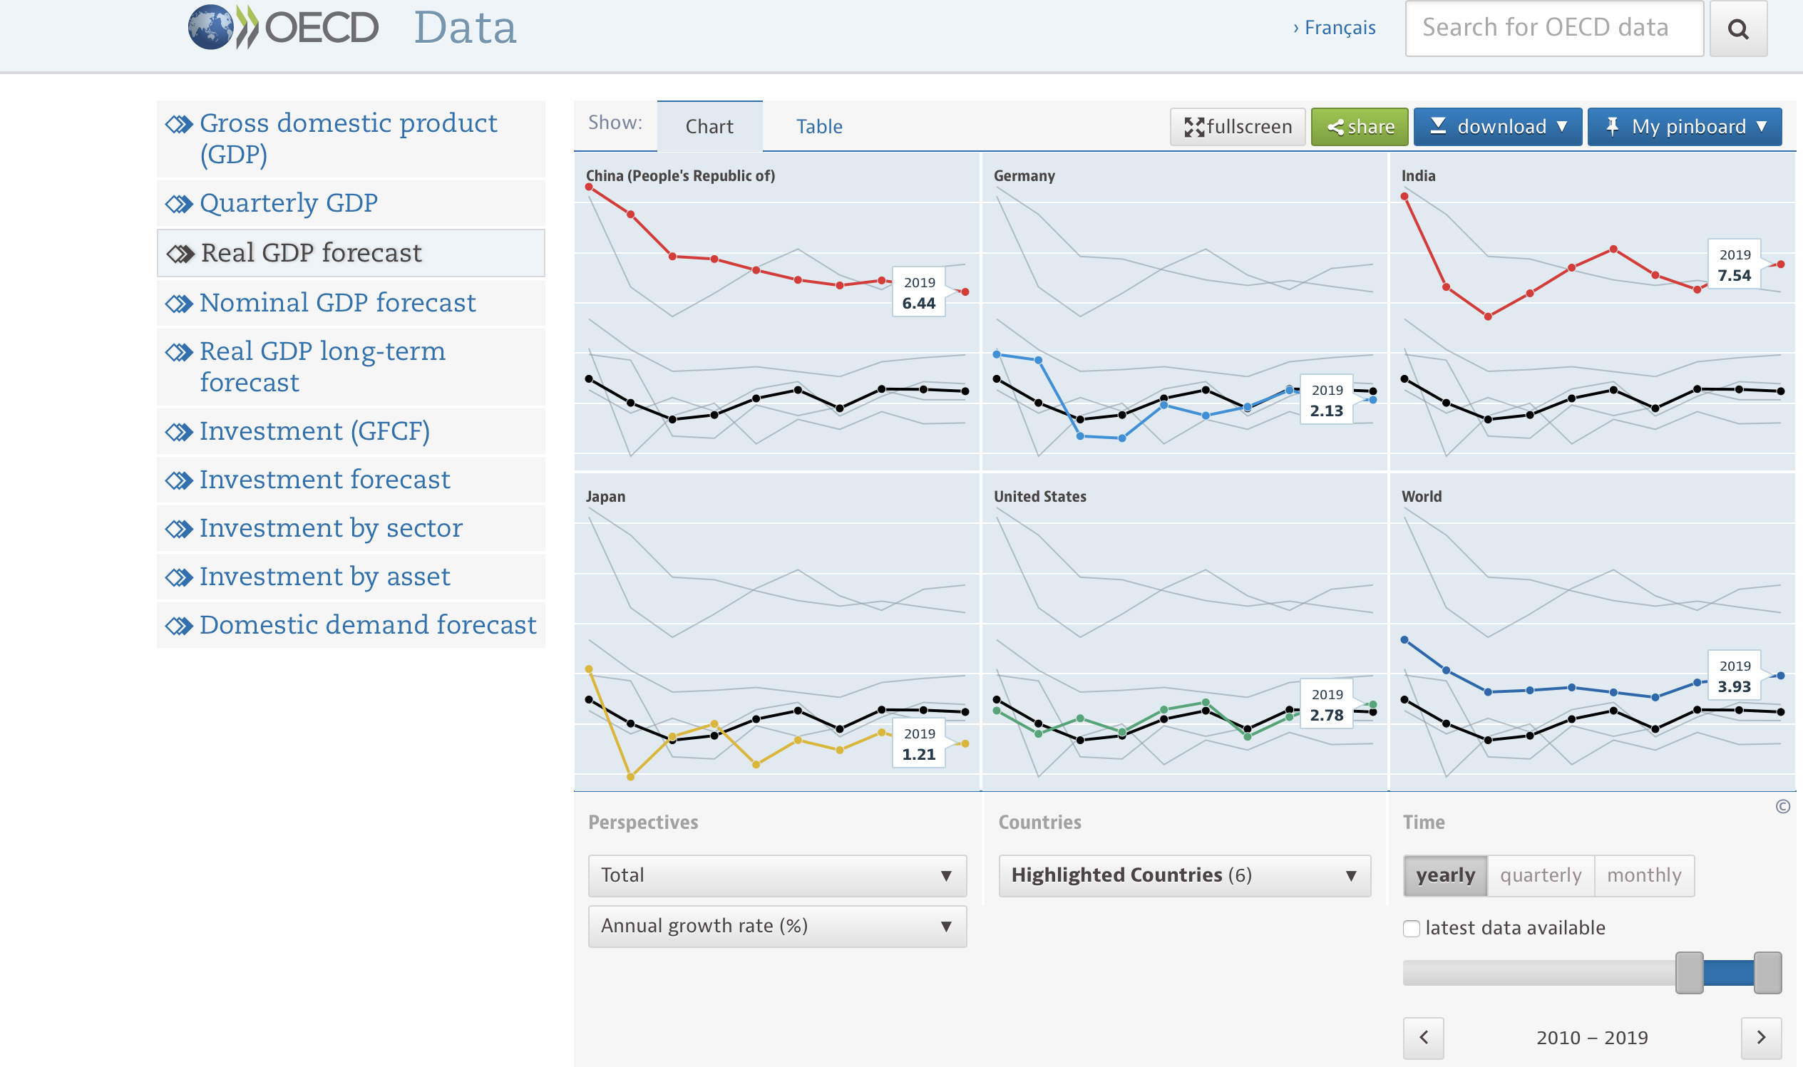
and projected to grow at the same rate.

Slide 13
Population is growing at only 0.5-1% per year.

Slide 14
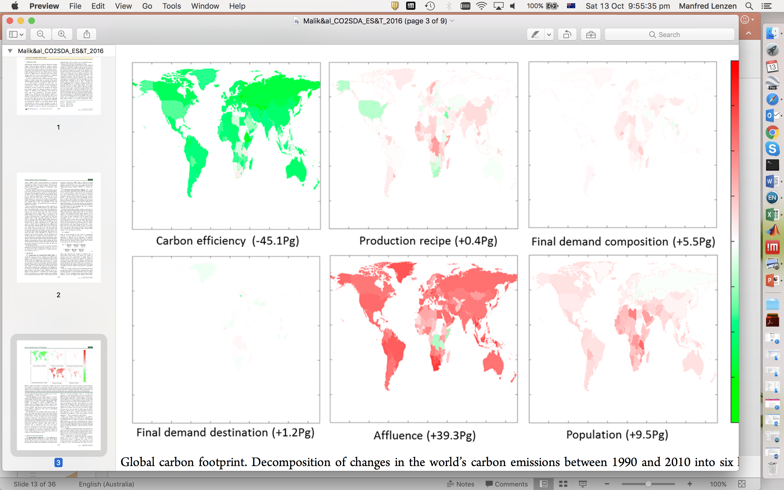
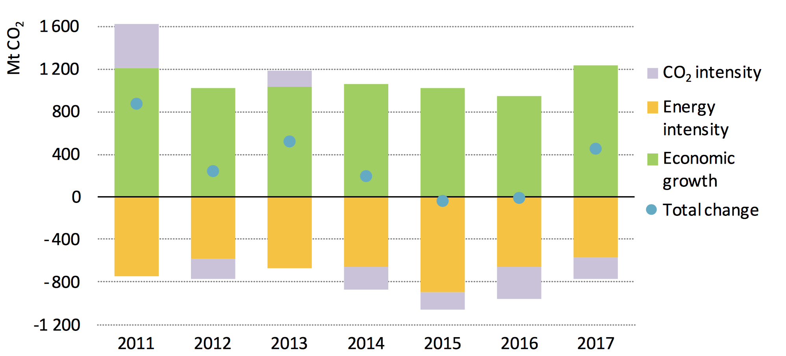
Affluence and population growth combined have been outstripping any technological gains.

Slide 15
This means that we need to address lifestyles.

Slide 16

IPCC carbon budgets: we have about 550 Gt CO₂-e left to have a 2-in-3 chance to stay below 1.5º.

Slide 17
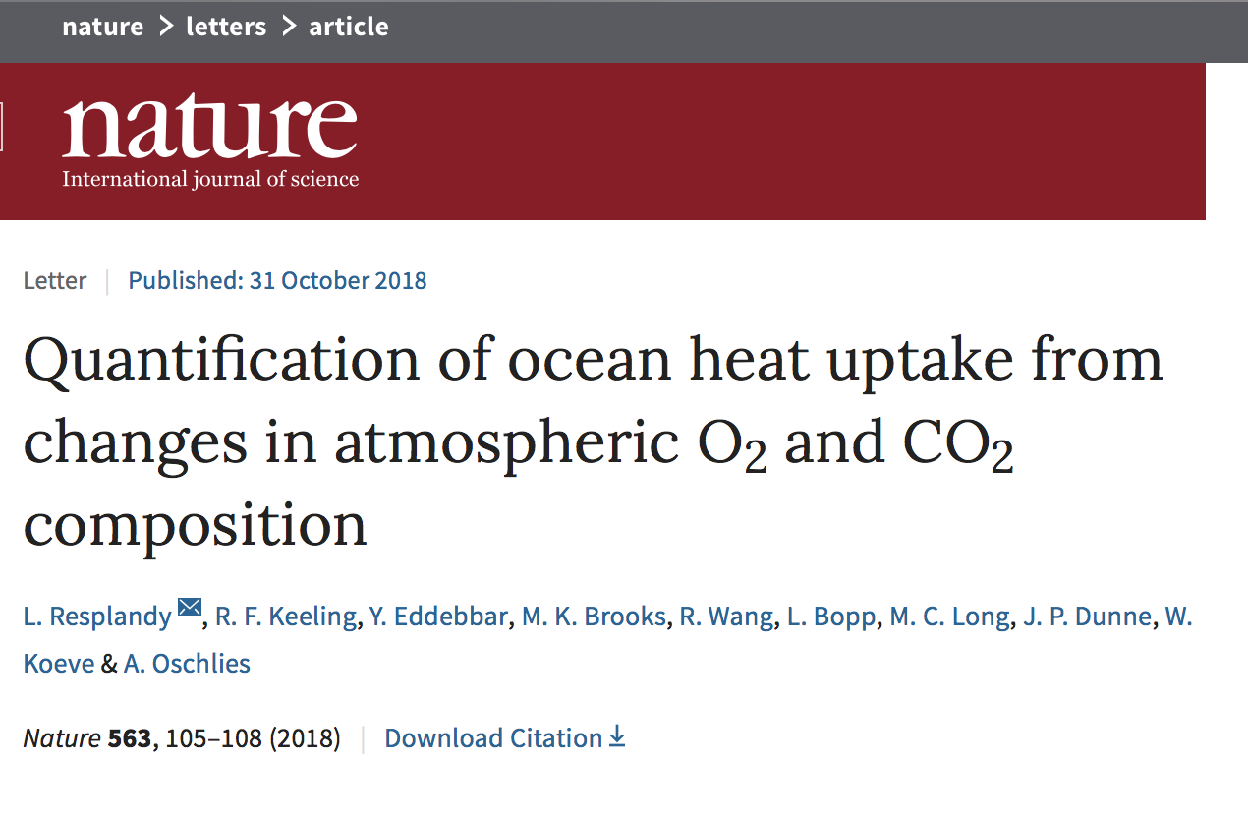
Bad news #1? New research indicates that the budget may be 25% smaller.

Slide 18
Every person has the same right to use this remaining budget to make a living and develop.

Slide 19
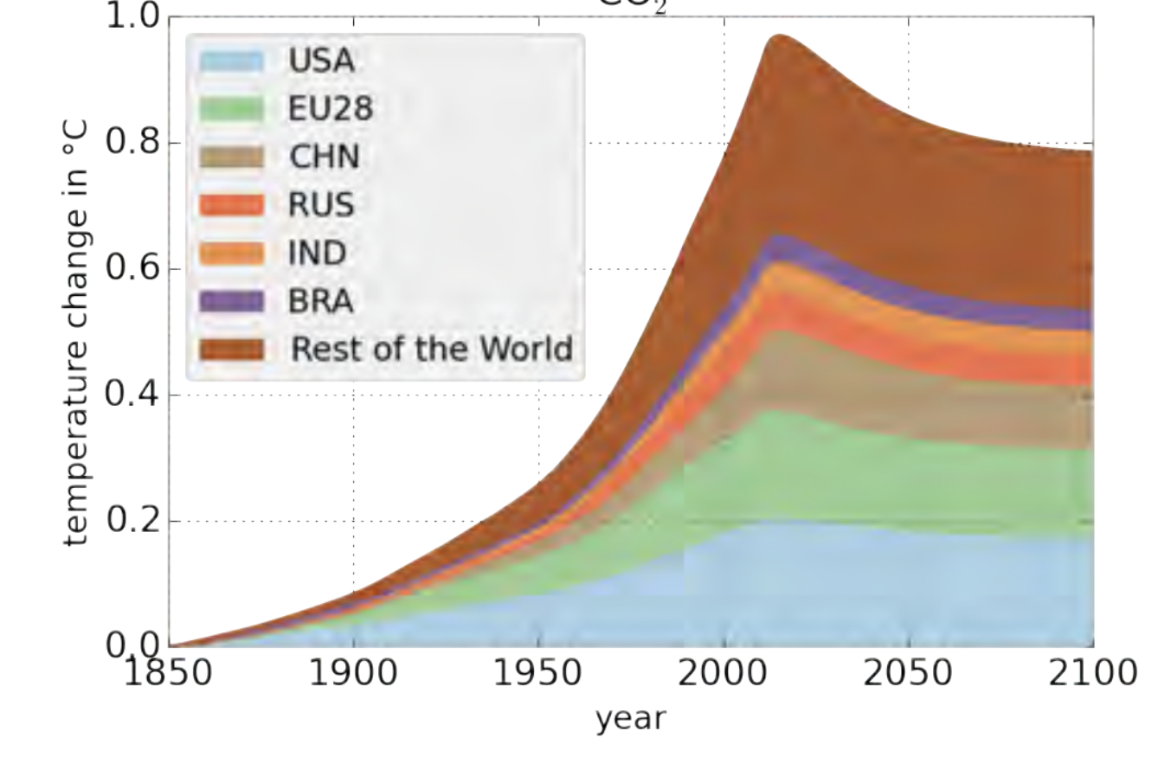
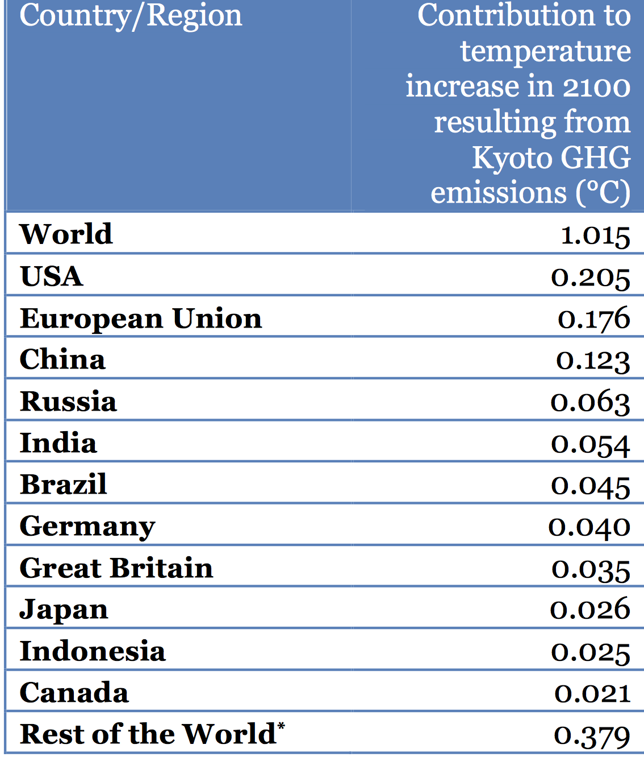
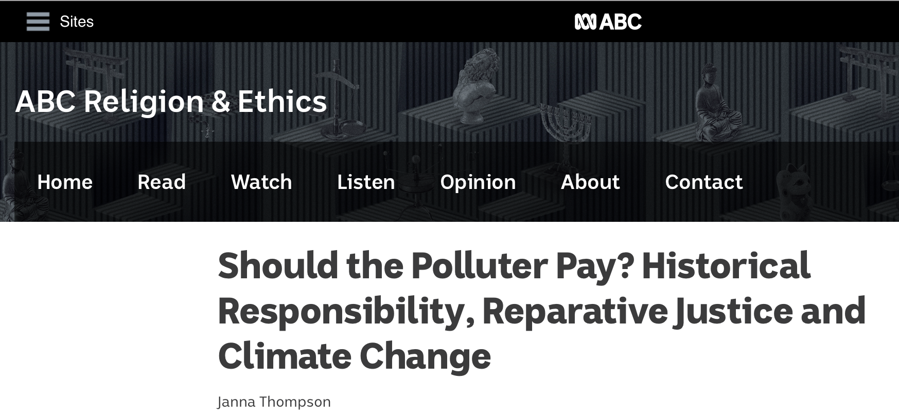
Bad news #2? Based on historical emissions rich-world citizens have already blown their share.

Slide 20
But let’s go with the far less extreme scenario
– dividing the remaining budget equally.

Slide 21
If we exceed the 1.5º trajectory, this budget will be exhausted earlier.

Slide 22
The 1.5º trajectory means 27.5 Gt CO₂-e in 2030.
This equates to about 3.6 t CO₂-e per capita.

Slide 23
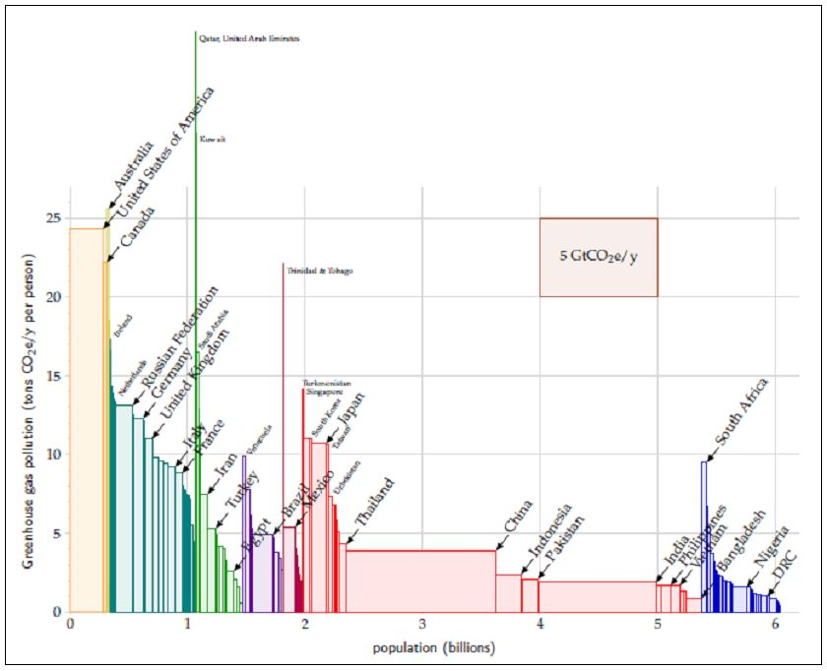
Affluent people emit more than 3.6 t CO₂-e.
Emission exporter, column should be lower
Emission outsourcers,
columns should be higher
Emission outsourcers,
columns should be higher
Lots of nuclear energy
Lots of hydro energy

Slide 24
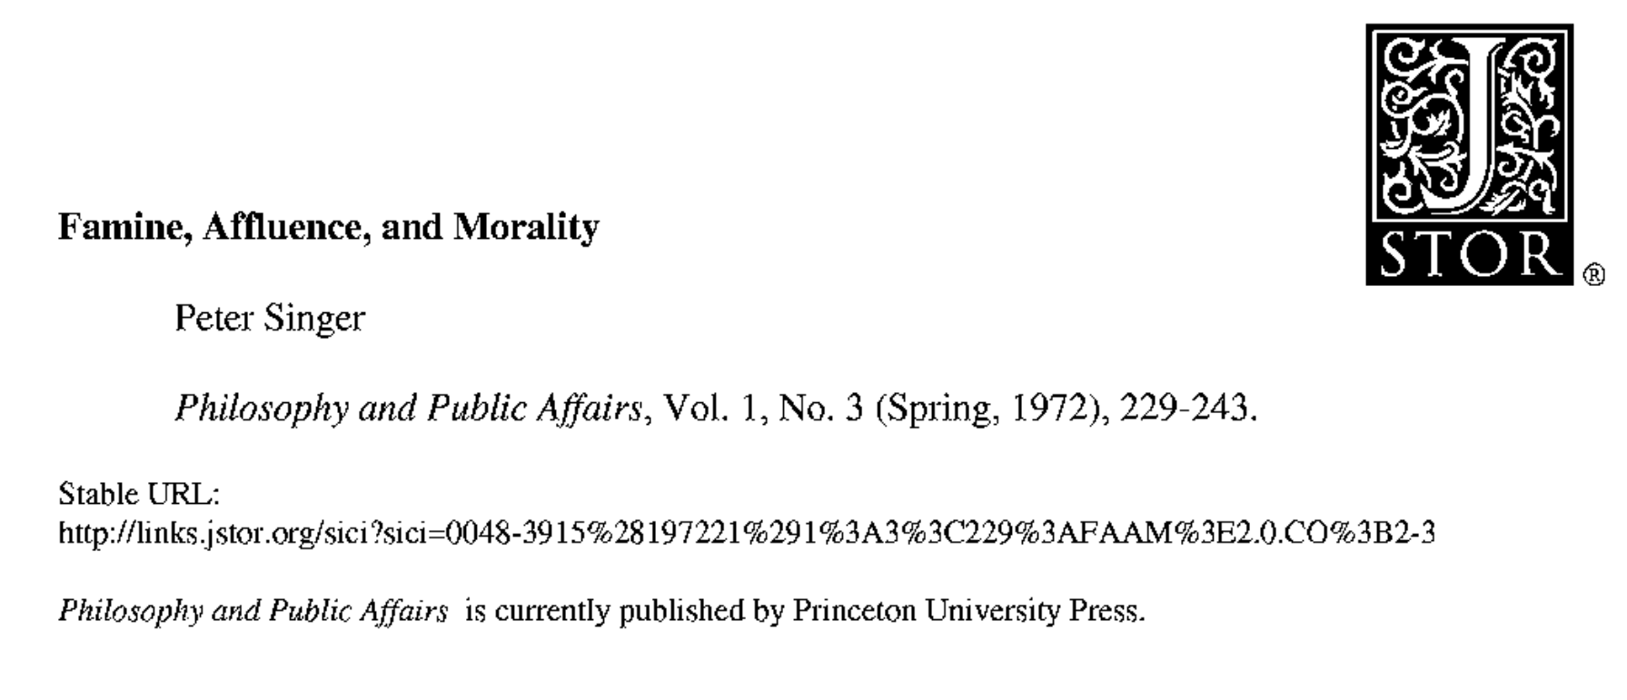
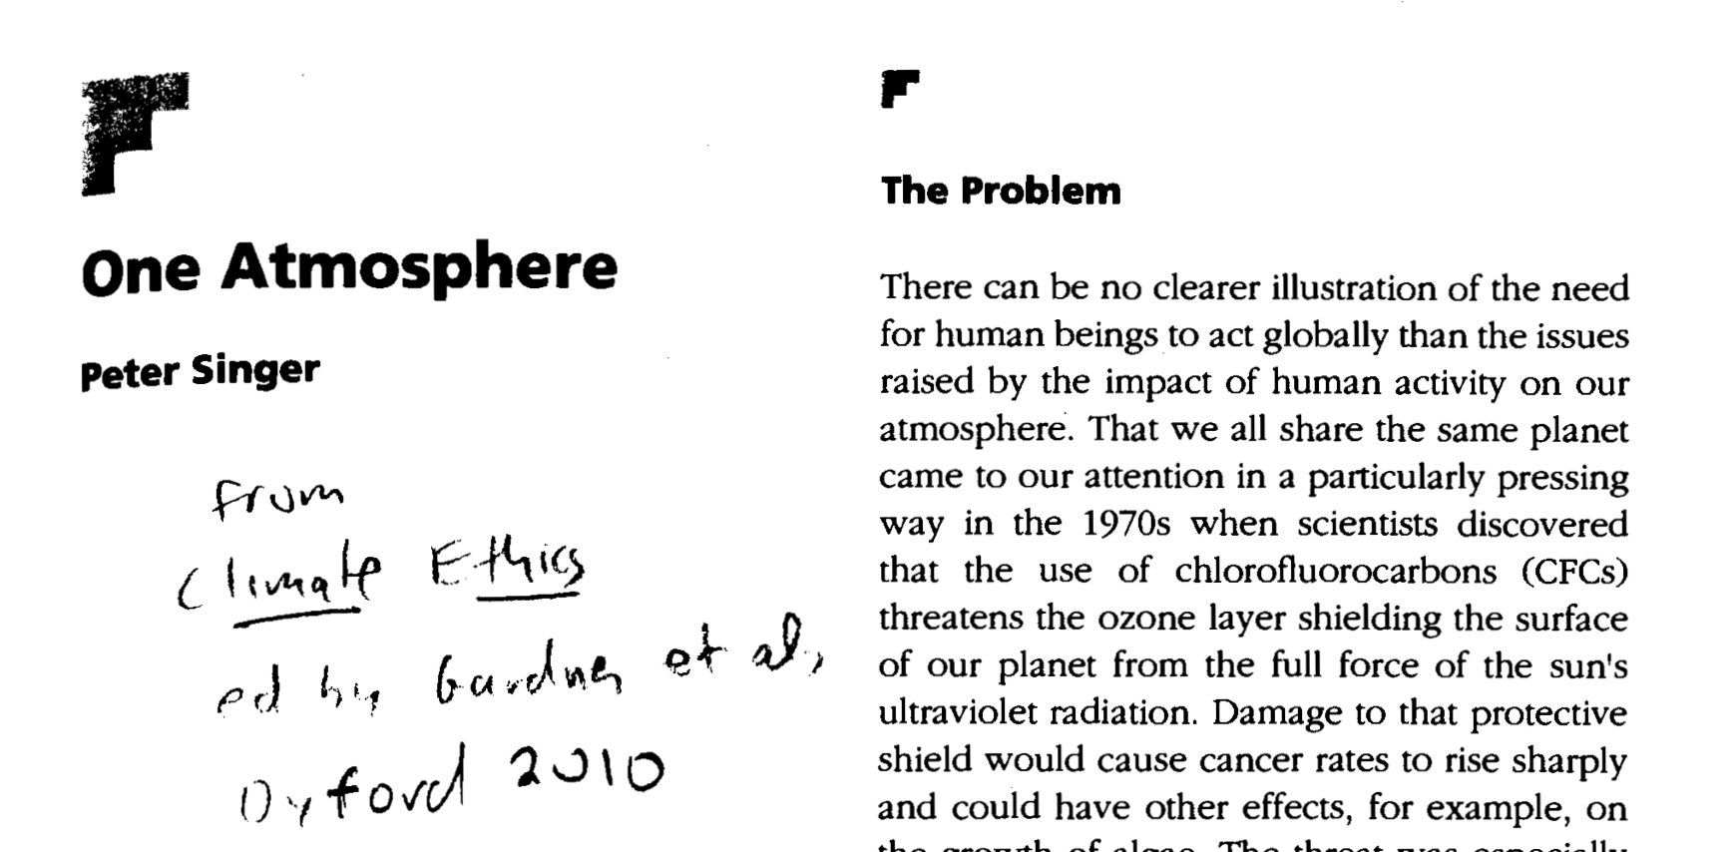
Considering global inequalities, affluent consumer behaviour has even been described as immoral.

Slide 25
Australians would need to reduce emissions by 80% to be on an equitable 1.5º trajectory.
- 80%

Slide 26
Could we reduce our emissions by that much?
Well, more than half of the world already lives on less than 3.6 t CO₂-e.

Slide 27
Technology could achieve a 30% reduction,
Energy intensity:
– 2% per year
+ Carbon intensity:
– 1% per year
= Emissions:
– 30% by 2030

Slide 28
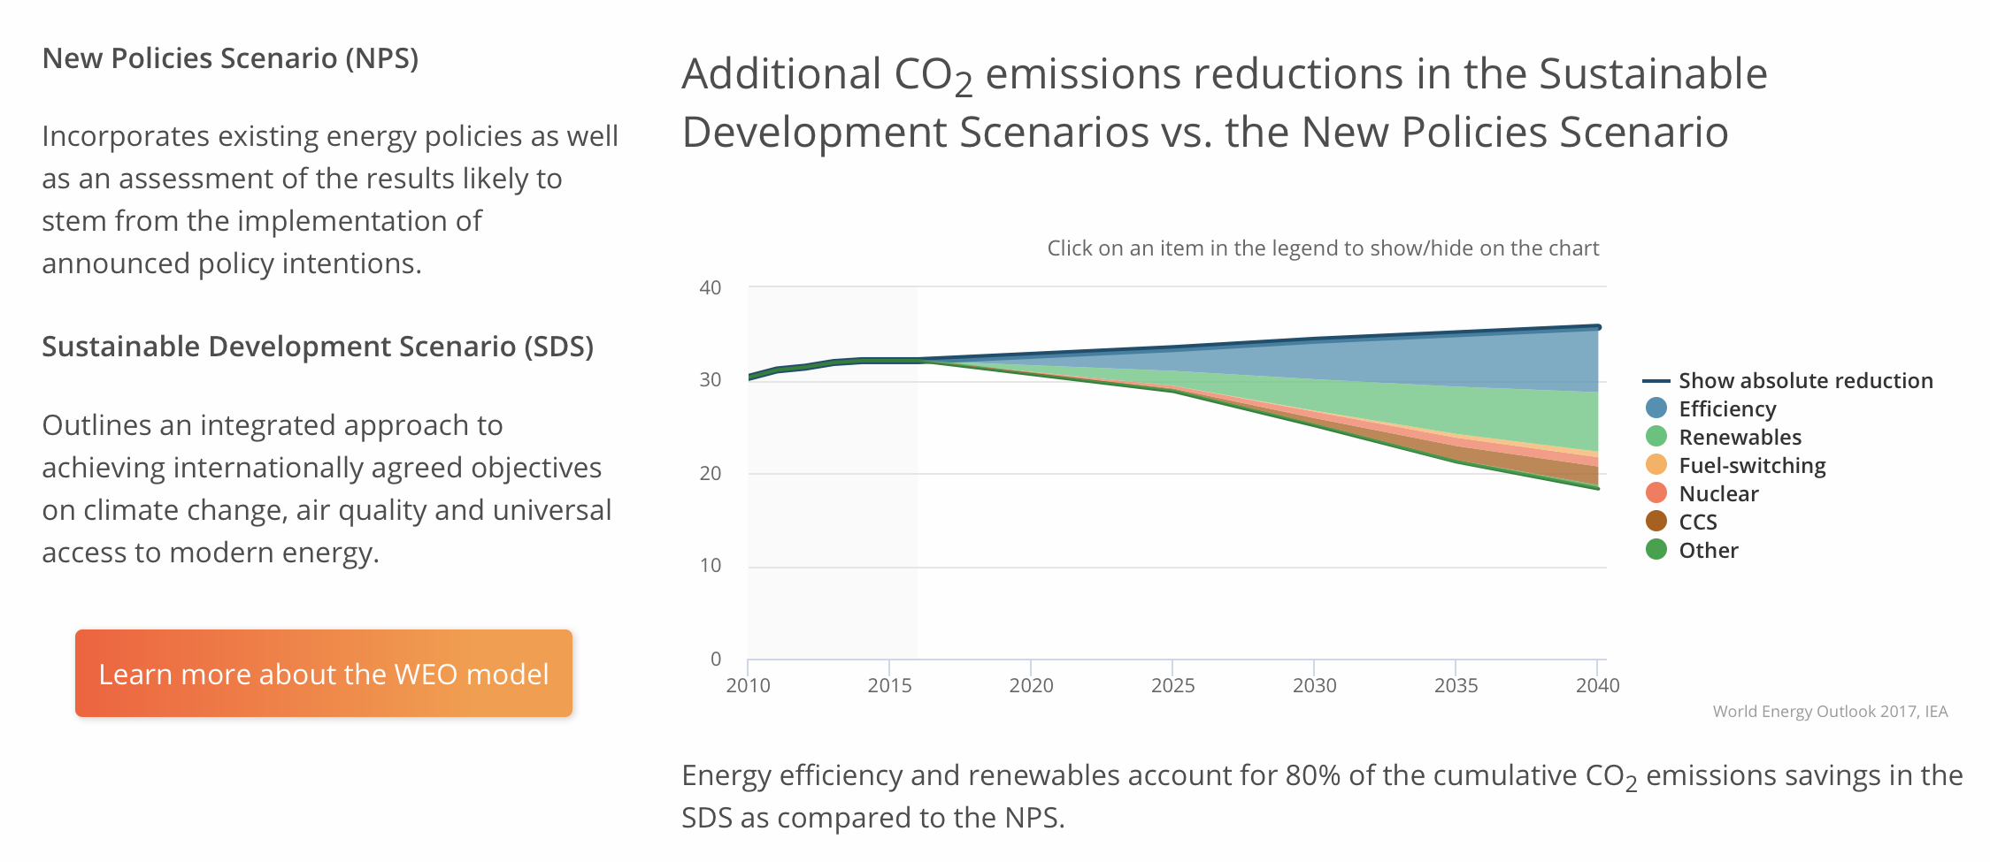
as confirmed in the IEA’s World Energy Outlook.

Slide 29
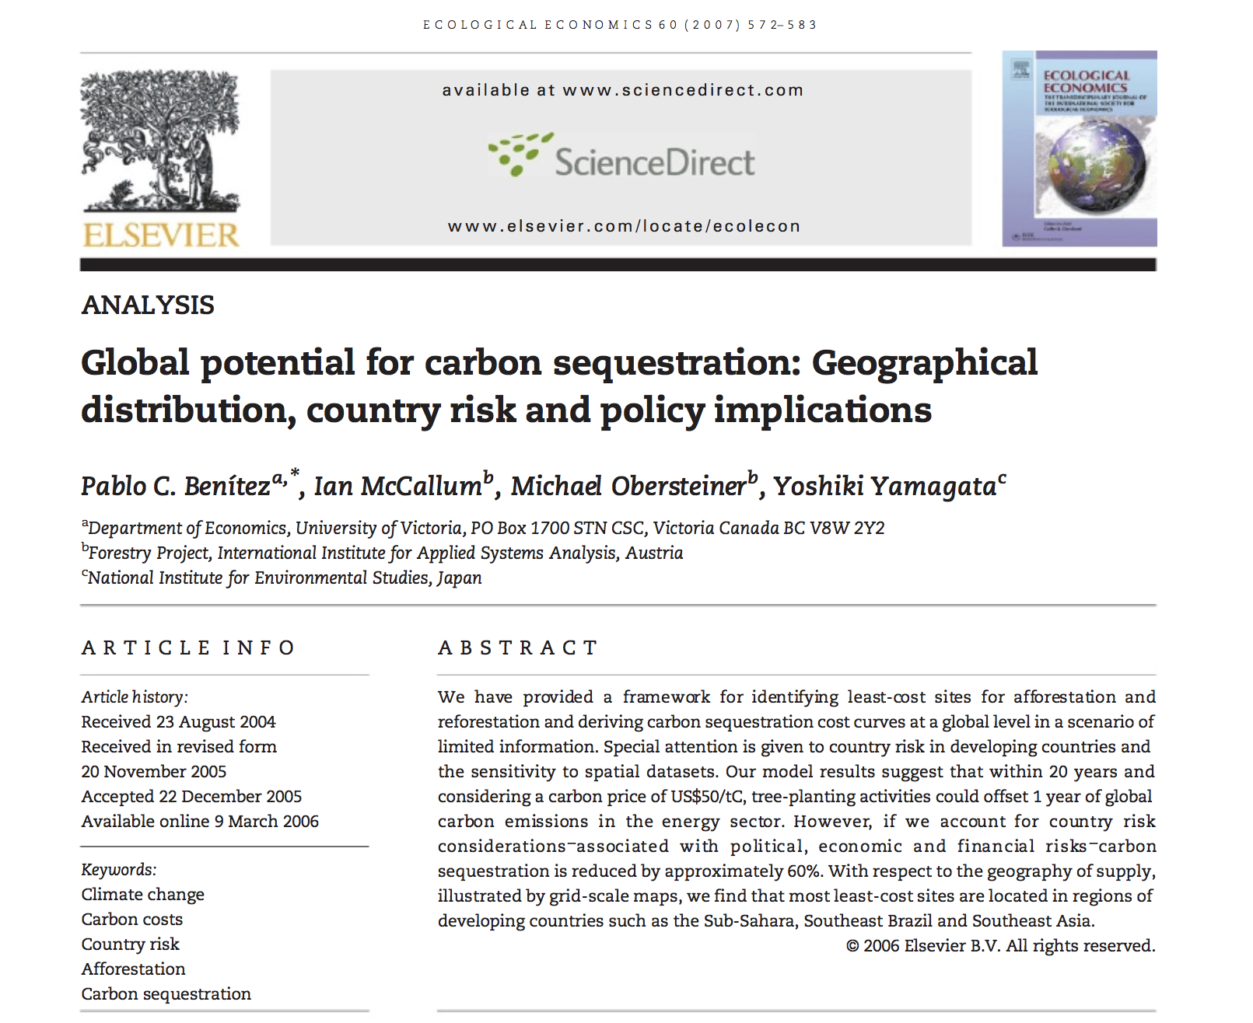
Sequestration could achieve between 5 and 10%.

Slide 30
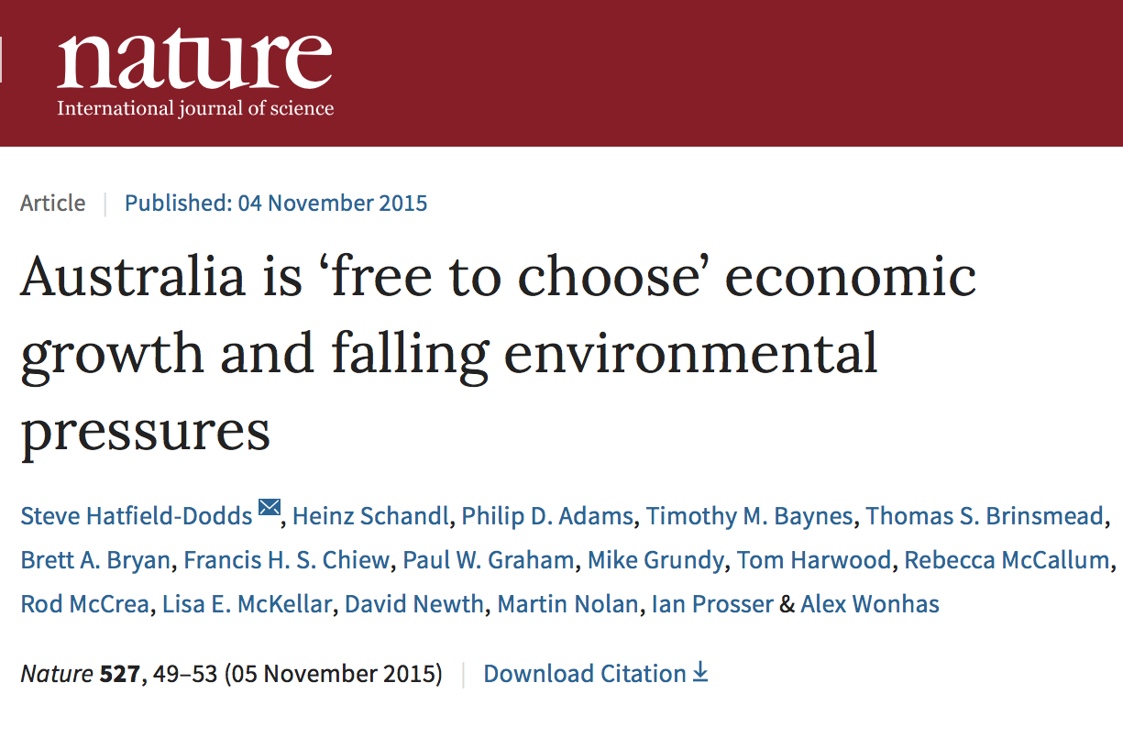
But an equitable 1.5º trajectory would lead us into uncharted technological territory,
Transition needed to support 1.5º trajectory:
10-fold acceleration of emission intensity improvements

Slide 31
there would still be 40% reduction left to deal with,

Slide 32
whilst all the time, affluence growth is trying hard to outrun technological gains !

Slide 33
Whilst we transition to cleaner technology, the world’s demands for energy are growing fast,

Slide 34
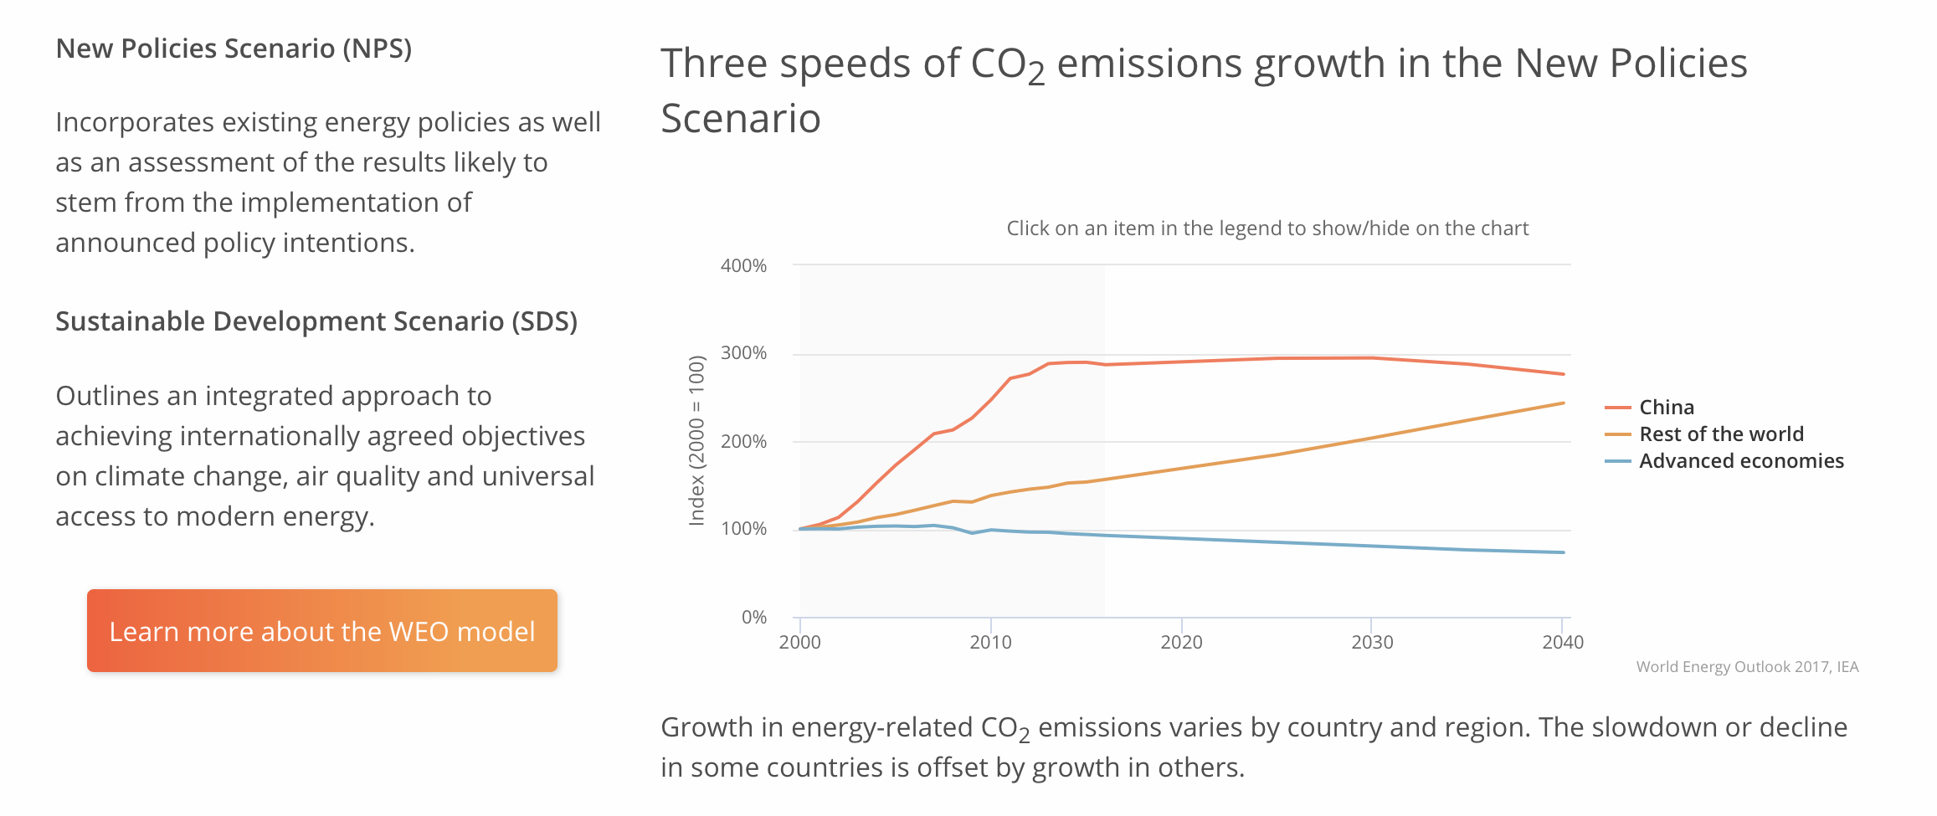
driving emissions up beyond 2030.

Slide 35
So, what about lifestyle changes?

Slide 36
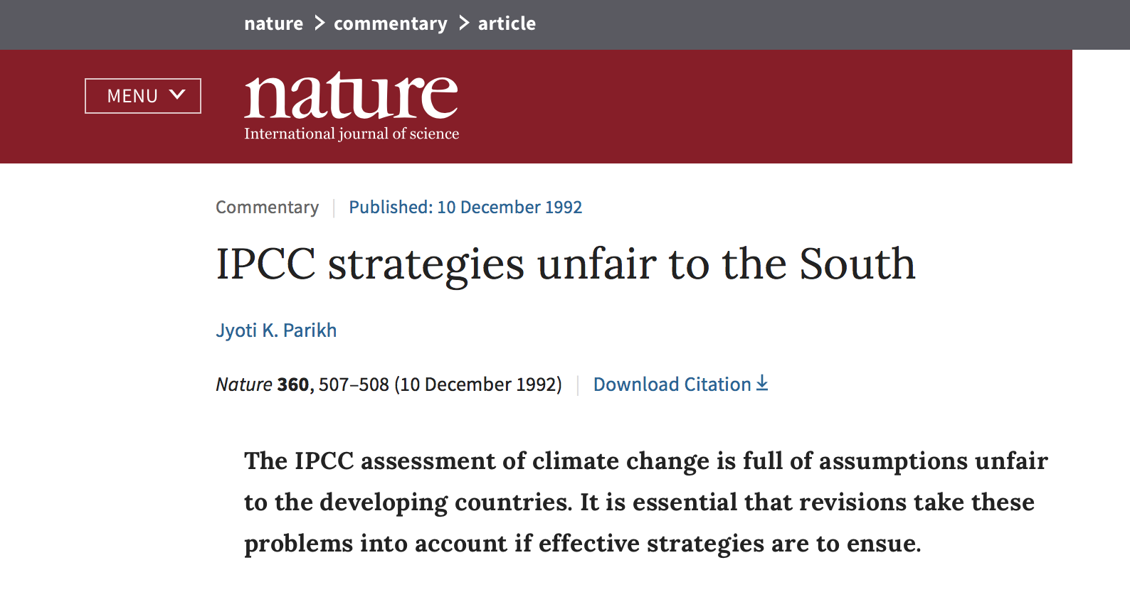
If people in India can live on less than 3.5 t CO2-e, why can’t we?

Slide 37
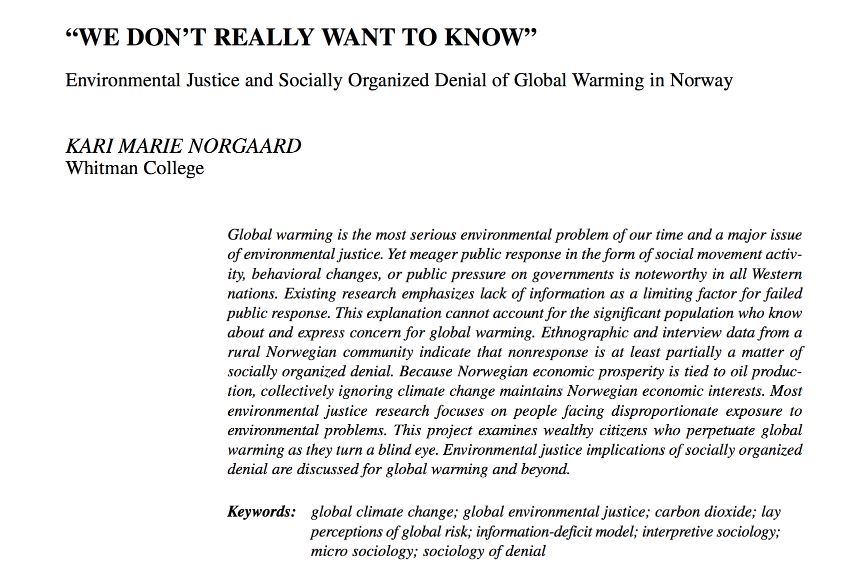
Maybe it’s not that we couldn’t (in principle), but that we don’t want to,

Slide 38
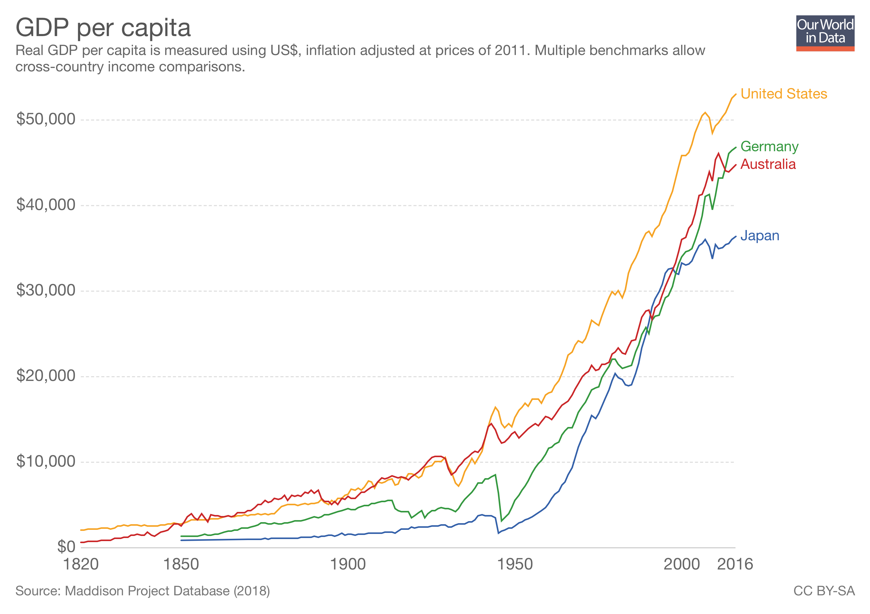
because significant reductions of economic activity are associated with conflict and crisis situations,
Global Financial Crisis
Great Depression
World War II

Slide 39
radical change is uncomfortable,

Slide 40
and we’d rather succumb to our addiction to affluence, retreat to our private lives,

Slide 41
and partake in widespread social denial of the reality of climate change.

Slide 42
There is ample evidence for this: the knowledge-concern-action paradox.
👍 👎
Knowledge ⇒ Concern ⇏ Action
W. Kempton, "Will public environmental concern lead to action on global warming?," Annual Review of Energy and the Environment, vol. 18, pp. 217-245, 1993.
E. Holden and K. Linnerud, "Environmental attitudes and household consumption: an ambiguous relationship," International Journal of Sustainable Development, vol. 13, no. 3, pp. 217-231, 2010.
S. Owens and L. Driffill, "How to change attitudes and behaviours in the context of energy," Energy Policy, vol. 36, no. 12, pp. 4412-4418, 2008.
L. Whitmarsh, G. Seyfang, and S. O'Neill, "Public engagement with carbon and climate change: To what extent is the public 'carbon capable'?," Global Environmental Change, vol. 21, no. 1, pp. 56-65, 2011.
L. Lutzenhiser, "Social and behavioral aspects of energy use," Annual Review of Energy and Environment, vol. 18, pp. 247-289, 1993.
D. Stokes, A. Lindsay, J. Marinopoulos, A. Treloar, and G. Wescott, "Household carbon dioxide production in relation to the greenhouse effect," Journal of Environmental Management, vol. 40, pp. 197-211, 1994.
B. McKibben, "Worried? Us?," Granta, vol. 83, pp. 7-12, 2003.
W. Poortinga, L. Steg, and C. Vlek, "Values, environmental concern, and environmental behaviour," Environment and Behavior, vol. 36, no. 1, pp. 70-93, 2004.
K. Vringer, T. Aalbers, and K. Blok, "Household energy requirement and value patterns," Energy Policy, vol. 35, no. 1, pp. 553-566, 2007.
E. G. Hertwich, "The environmental effect of car-free housing: A case in Vienna," Ecological Economics, vol. 65, no. 3, pp. 516-530, 2008.
B. Gatersleben, L. Steg, and C. Vlek, "Measurement and determinants of environmentally significant consumer behavior," Environment and Behavior, vol. 34, pp. 335-362, 2002.

Slide 43
“Simple, easy!”
Our society does its part in supporting this denial.

Slide 44
So are we stuck between a rock and a hard place?
1. Face the whole challenge and
get paralysed by guilt, anger and depression?
2. Make the transition palatable and
fall woefully short of even the 2º target?

Slide 45
3 Thoughts for Anthropoceneans
1. Accept that the things we can do easily may have little or negligible impact.
2. Accept that we are reluctant to embark on the necessary radical changes
to our comfortable and convenient lives,
even at the cost of the present poor,
and future generations.
3. Get prepared for grief.

